Slide 2
Continuous Deployment for Plugins
Joseph Clark
Plugin Developer, Atlassian

Slide 3










Slide 4
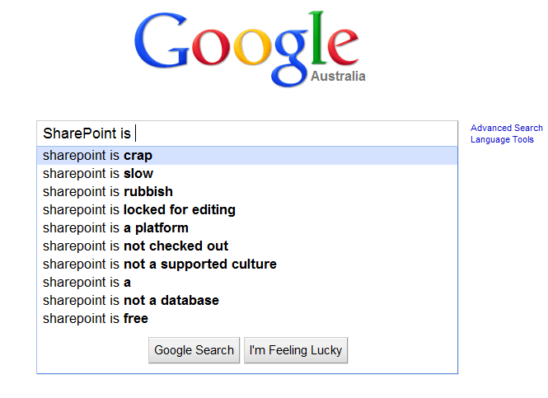

Slide 5

What is it?
Tooling
“Continuous”... or not.

Slide 6
Why should you care?
Speed
Cost
A natural progression from Continuous Integration
User Confidence

Slide 7


Slide 8


Slide 9
Getting started…
Plugins 2
Target System
Some kind of automation
How often?

Slide 10
A simple example
curl https://confluence/admin/uploadplugin.action -u admin:admin --location-trusted -k -–header "Content-Type: multipart/mixed“ -–header "X-Atlassian-Token: no-check“ -–form "file_0=@$jar

Slide 11





Getting fancy with Bamboo
Compile Task
Deploy Task

Slide 12


Demo...
https://bitbucket.org/jaysee00/bamboo-continuous-plugin-deployment
https://plugins.atlassian.com/plugin/details/602870

Slide 13
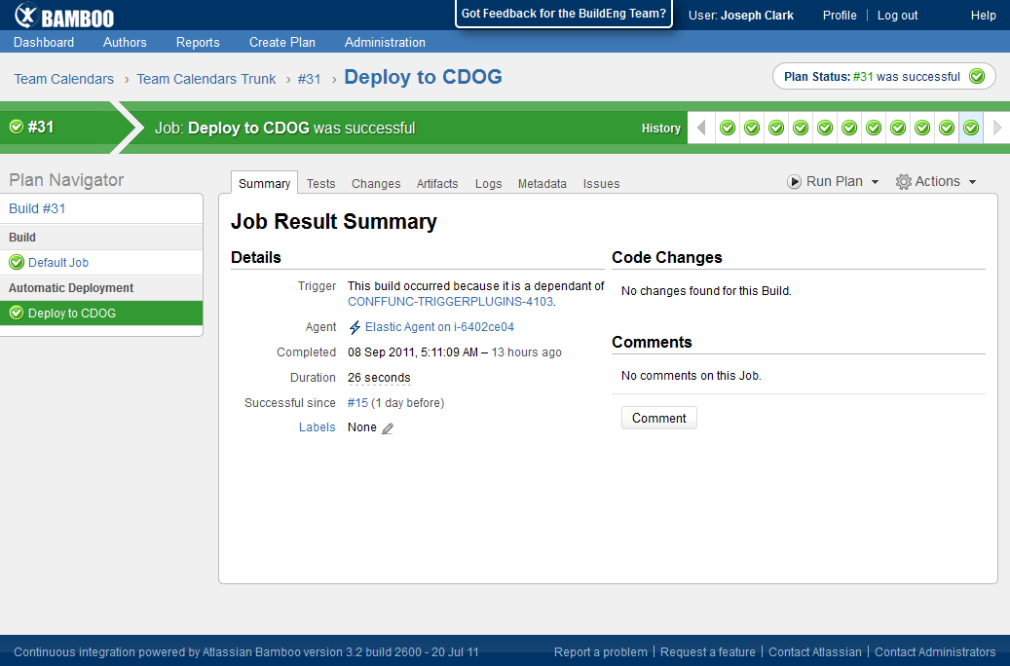

Slide 14

Getting feedback…
It takes a certain kind of person
Golden rule: make it simple

Slide 15
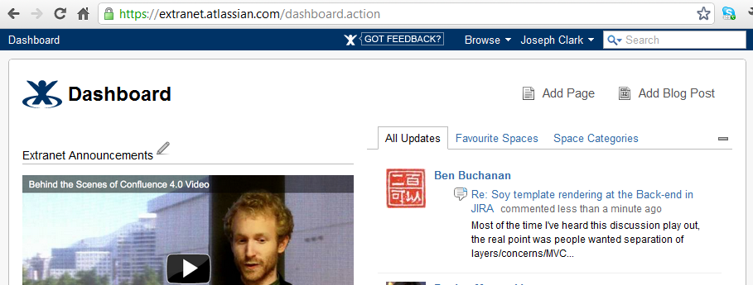
Use a plugin, stupid!

Slide 16
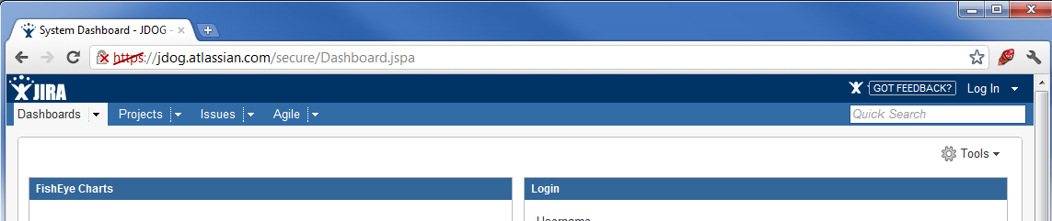
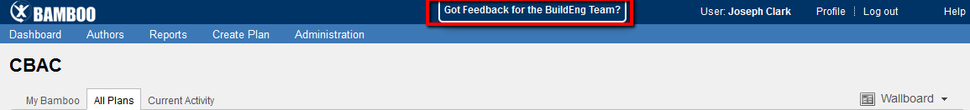

Slide 17
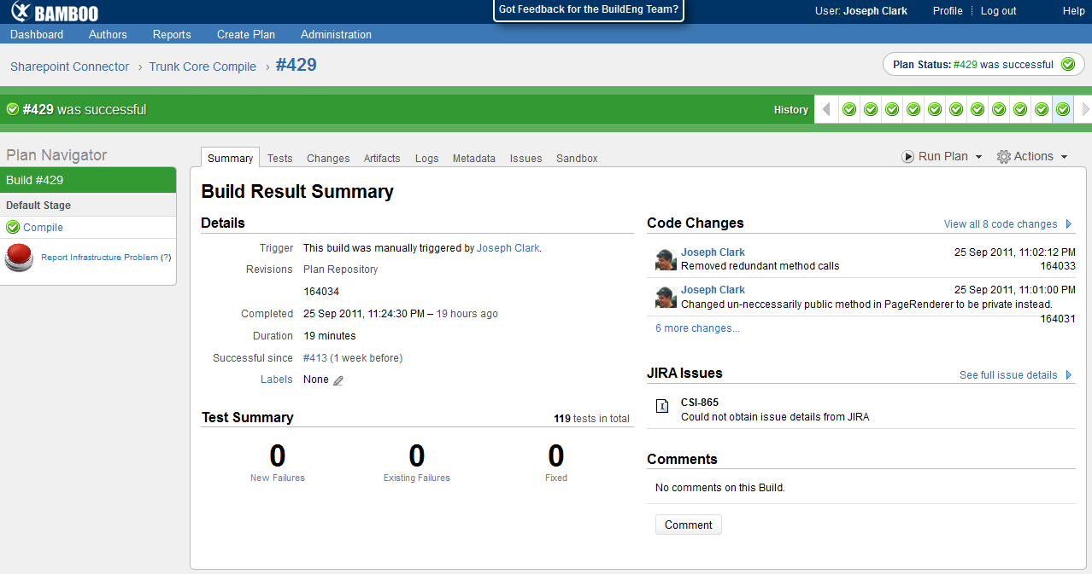

Slide 18
Demo...
https://bitbucket.org/sherif/confluence-eap-feedback-plugin/overview
https://plugins.atlassian.com/plugin/details/583856

Slide 19
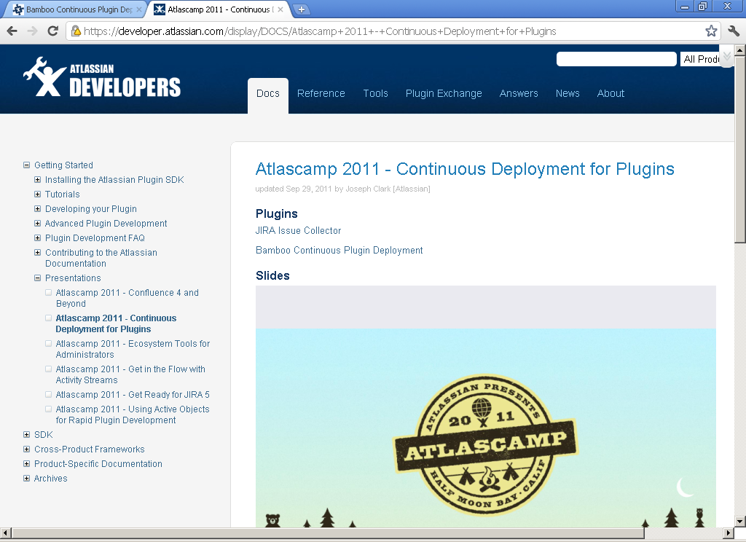

Slide 20

Contacting me...
@jaysee00
jclark@atlassian.com
answers.atlassian.com/users/123/joseph-clark-atlassian/

Slide 21

“
Make your plugin the best it can be – deploy regularly and encourage user feedback.
Bamboo & JIRA ftw!
”
”

Slide 22
Thank you!

